Slide 1
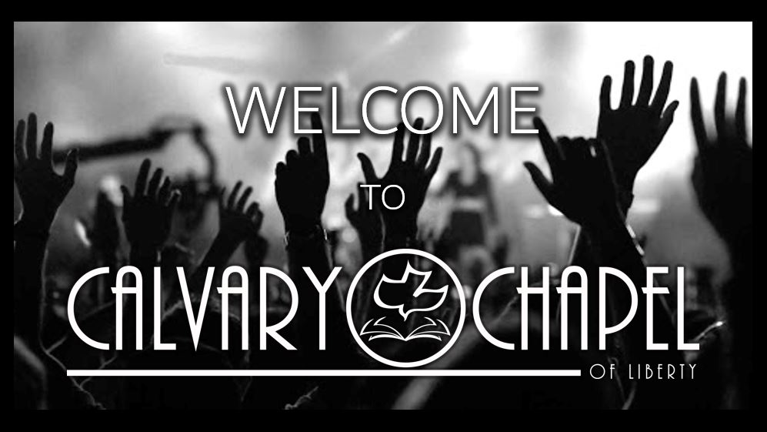

Slide 2
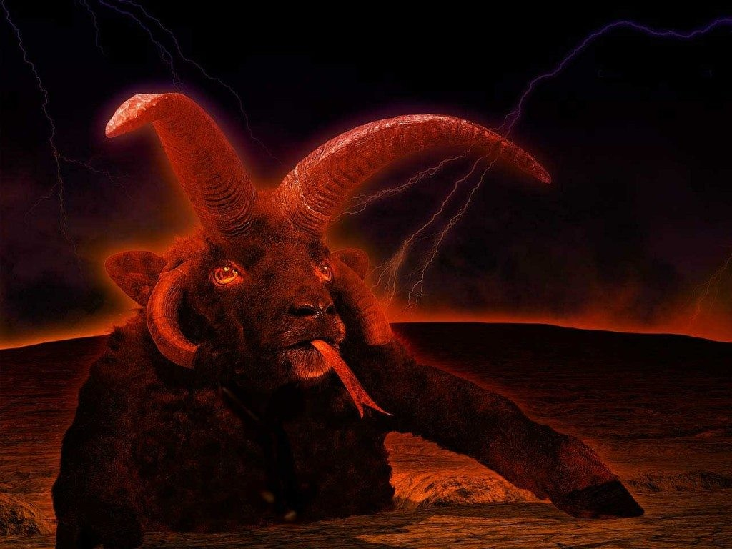
Revelation 13:11-18

Slide 3
Revelation 13:11
11 Then I saw another beast coming up out of the earth, and he had two horns like a lamb and spoke like a dragon.

Slide 4
Revelation 13:12
12 And he exercises all the authority of the first beast in his presence, and causes the earth and those who dwell in it to worship the first beast, whose deadly wound was healed.

Slide 5
Revelation 13:13
13 He performs great signs, so that he even makes fire come down from heaven on the earth in the sight of men.

Slide 6
Revelation 13:14
14 And he deceives those who dwell on the earth—by those signs which he was granted to do in the sight of the beast, telling those who dwell on the earth to make an image to the beast who was wounded by the sword and lived.

Slide 7
Revelation 13:15
15 He was granted power to give breath to the image of the beast, that the image of the beast should both speak and cause as many as would not worship the image of the beast to be killed.

Slide 8
Revelation 13:16
16 He causes all, both small and great, rich and poor, free and slave, to receive a mark on their right hand or on their foreheads,

Slide 9
Revelation 13:17
17 and that no one may buy or sell except one who has the mark or the name of the beast, or the number of his name.

Slide 10
Revelation 13:18
18 Here is wisdom. Let him who has understanding calculate the number of the beast, for it is the number of a man: His number is 666.

Slide 11
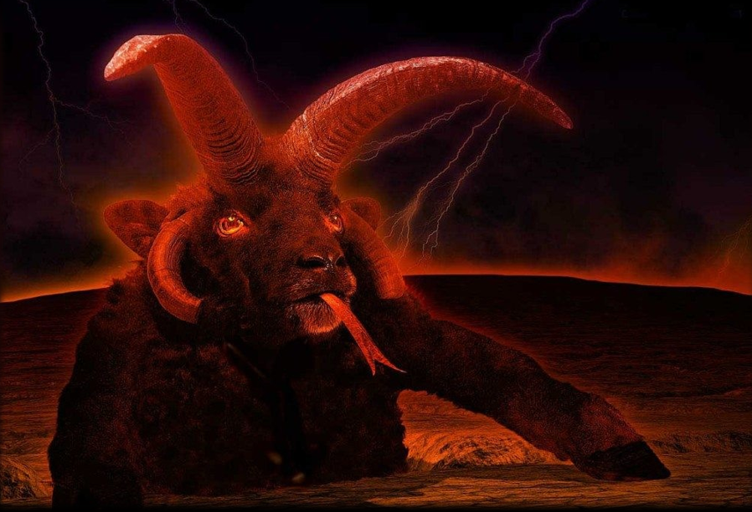
Revelation 13:11
11 Then I saw another beast coming up out of the earth, and he had two horns like a lamb and spoke like a dragon.
The Unholy Trinity: Dragon = serpent, Satan (Rev. 12:9).
The first beast = Anti-Christ).
The second beast = Anti-Holy Spirit, false prophet.

Slide 12
The Two Beasts of Revelation 13
• Beast out of the Sea (Anti-Christ):
– 7 Heads, 10 Horns.
– Heads with the name of blasphemy.
– One of heads: deadly wound healed.
– Powered by the Dragon for 42 months.
– Overcomes the Saints.
– Earth-Dwellers worship.
• All those not written in the Book of Life.
• Beast out of the Earth (“False Prophet”):
– Two horns like Lamb.
– Speaks as the Dragon.
– Causes Earth to worship the 1st Beast.
– Deceives the Earth with miracles.
– Forces worship of an image of 1st Beast.
• All receive mark in right hands or foreheads.
• No man may buy or sell without the name or number of the 1st Beast: 666.

Slide 13
Revelation 13:11
11 Then I saw another beast coming up out of the earth, and he had two horns like a lamb and spoke like a dragon.
Two is the number of testimony.

Slide 14
John 15:26
26 “But when the Helper comes, whom I shall send to you from the Father, the Spirit of truth who proceeds from the Father, He will testify of Me.

Slide 15
Revelation 13:11
11 Then I saw another beast coming up out of the earth, and he had two horns like a lamb and spoke like a dragon.
Two is the number of testimony.
Lamb = Little lamb in Gk.
Spoke the words of the dragon.
Dragon = Serpent in Gk.

Slide 16
Revelation 13:12
12 And he exercises all the authority of the first beast in his presence, and causes the earth and those who dwell in it to worship the first beast, whose deadly wound was healed.

Slide 17
Revelation 13:13
13 He performs great signs, so that he even makes fire come down from heaven on the earth in the sight of men.

Slide 18
Revelation 13:14
14 And he deceives those who dwell on the earth by those signs which he was granted to do in the sight of the beast, telling those who dwell on the earth to make an image to the beast who was wounded by the sword and lived.

Slide 19
Revelation 13:12
12 And he exercises all the authority of the first beast in his presence, and causes the earth and those who dwell in it to worship the first beast, whose deadly wound was healed.

Slide 20
Revelation 13:15
15 He was granted power to give breath to the image of the beast, that the image of the beast should both speak and cause as many as would not worship the image of the beast to be killed.
Granted = “to grant what is hue” or “to pay one’s wage”

Slide 21
Revelation 13:16
16 He causes all, both small and great, rich and poor, free and slave, to receive a mark on their right hand or on their foreheads,

Slide 22
Revelation 13:17
17 and that no one may buy or sell except one who has the mark or the name of the beast, or the number of his name.

Slide 23
Revelation 13:18
18 Here is wisdom. Let him who has understanding calculate the number of the beast, for it is the number of a man: His number is six hundred and sixty-six.

